Slide 1

May 2018
Bangalore
KNN,Bagging,Boosting
In R
May 2018
Bangalore

Slide 2
KNN
KNN (K Nearest Neighbours)is a non-parametric, lazy learning algorithm. Its purpose is to use a database in which the data points are separated into several classes to predict the classification of a new sample point.
When we say a technique is non-parametric , it means that it does not make any assumptions on the underlying data distribution. In other words, the model structure is determined from the data. If you think about it, it’s pretty useful, because in the “real world”, most of the data does not obey the typical theoretical assumptions made (as in linear regression models, for example). Therefore, KNN could and probably should be one of the first choices for a classification study when there is little or no prior knowledge about the distribution data.

Slide 3

KNN
KNN is also a lazy algorithm. Does that mean that KNN does nothing, like these polar bears imply??? Not quite. What this means is that it does not use the training data points to do any generalization. In other words, there is no explicit training phaseor it is very minimal. This also means that the training phase is pretty fast . Lack of generalization means that KNN keeps all the training data. To be more exact, all (or most) the training data is needed during the testing phase.

Slide 4
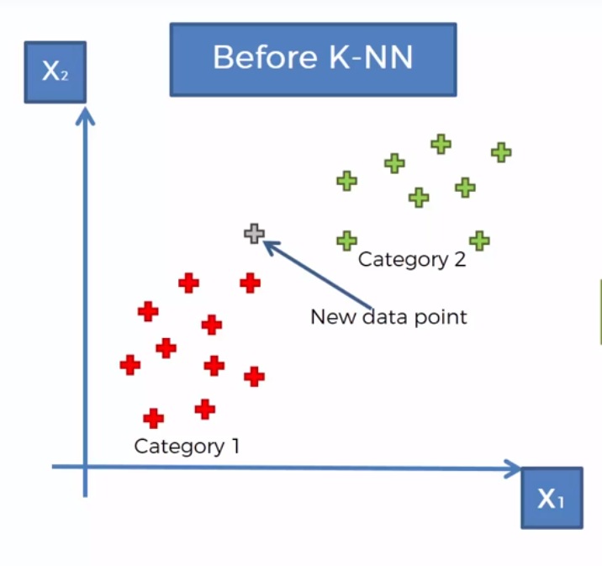
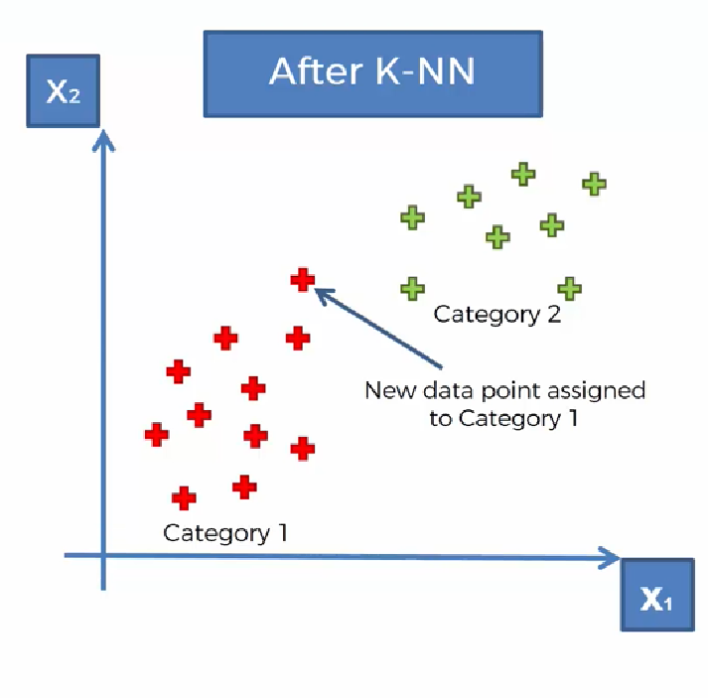
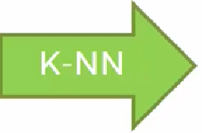
KNN

Slide 5
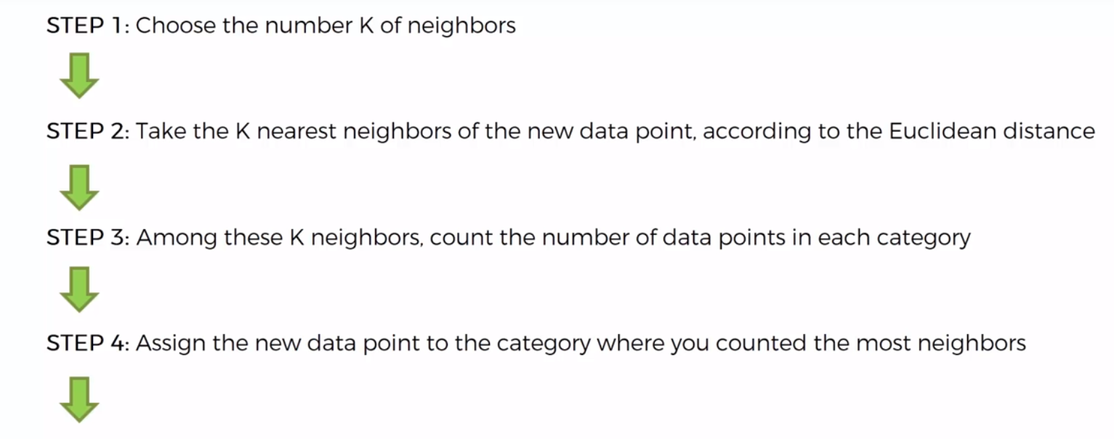
Steps For KNN
Model is Ready

Slide 6
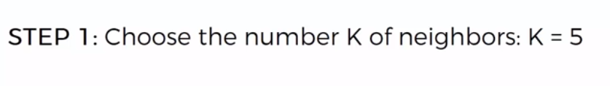
Steps For KNN

Slide 7
Time Series Forecasting
Time series analysis comprises methods for analyzing time series data in order to extract meaningful statistics and other characteristics of the data.
Time series forecasting is the use of a model to predict future values based on previously observed values.
While regression analysis is often employed in such a way as to test theories that the current values of one or more independent time series affect the current value of another time series,this type of analysis of time series is not called "time series analysis", which focuses on comparing values of a single time series or multiple dependent time series at different points in time.

Slide 8
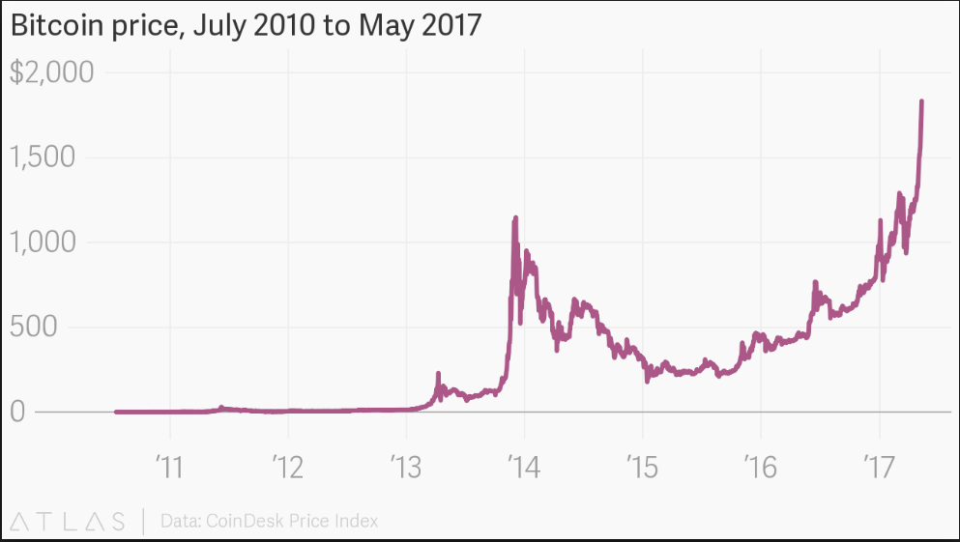
Time Series Forecasting

Slide 9
Time Series Forecasting
A common goal of time series analysis is extrapolating past behavior into the future.
Time series analysis is a statistical technique that deals with time series data, or trend analysis.
Time series data means that data is in a series of particular time periods or intervals
In statistics and econometrics, a distributed lag model is a model for time series data in which a regression equation is used to predict current values of a dependent variable
Based on both the current values of an explanatory variable and the lagged(past period) values of this explanatory variable.
A trend analysis is an aspect of technical analysis that tries to predict the future movement of a stock based on past data.
Trend analysis is based on the idea that what has happened in the pastgives traders an idea of what will happen in the future.

Slide 10
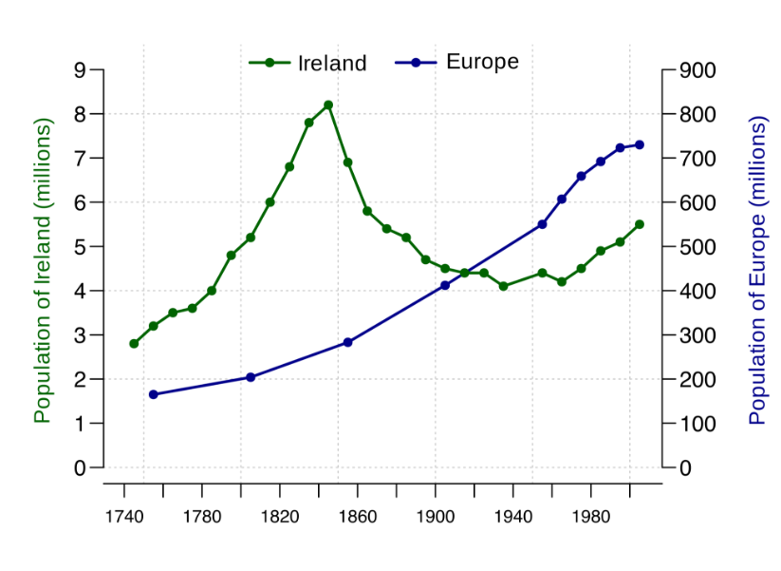
Time Series Forecasting
Graphs Used to Visualise Time Series Data
Line Graph:
A line graph is the simplest and most preferred way to represent time series data. It is intuitive, easy to create, and helps the viewer get a quick sense of how something has changed over time.

Slide 11
Steps For Time Series Forecasting
Step 1: Problem definition:
Defining the problem carefully requires an understanding of the way the forecasts will be used, who requires the forecasts, and how the forecasting function fits within the organization requiring the forecasts. A forecaster needs to spend time talking to everyone who will be involved in collecting data, maintaining databases, and using the forecasts for future planning.
Step 2: Gathering information:
There are always at least two kinds of information required:
(a) statistical data
(b) the accumulated expertise of the people who collect the data and use the forecasts.
Step 3: Preliminary (exploratory) analysis:
Always start by graphing the data. Are there consistent patterns? Is there a significant trend? Is seasonality important? Is there evidence of the presence of business cycles? Are there any outliers in the data that need to be explained by those with expert knowledge? How strong are the relationships among the variables available for analysis? Various tools have been developed to help with this analysis.

Slide 12
Steps For Time Series Forecasting
Step 4: Choosing and fitting models:
The best model to use depends on the availability of historical data, the strength of relationships between the forecast variable and any explanatory variables, and the way the forecasts are to be used.
Step 5: Using and evaluating a forecasting model:
Once a model has been selected and its parameters estimated, the model is used to make forecasts. The performance of the model can only be properly evaluated after the data for the forecast period have become available.

Slide 13
Bagging
Bootstrap aggregating, also called bagging, is a machine learning ensemble meta-algorithm designed to improve the stability and accuracy of machine learning algorithms used in statistical classification and regression. It also reduces variance and helps to avoid overfitting. Although it is usually applied to decision tree methods, it can be used with any type of method. Bagging is a special case of the model averaging approach.
Bagging is used typically when you want to reduce the variance while retaining the bias. This happens when you average the predictions in different spaces of the input feature space.
In bagging, first you will have to sample the input data (with replacement) to generate multiple sets of input data. For each of those sets, the same baseline predictor (such as a SVM, Neural Net, etc) is run to get a trained model for each of the training set.
Now, to do the prediction on an unseen test sample, it is run through these individual models and the predictions are now averaged to get the final decision.

Slide 14
Boosting
Boosting is a machine learning ensemble meta-algorithm for primarily reducing bias, and also variance in supervised learning, and a family of machine learningalgorithms that convert weak learners to strong ones. Algorithms that achieve hypothesis boosting quickly became simply known as "boosting".
Boosting grants power to machine learning models to improve their accuracy of prediction.
Let’s understand this definition in detail by solving a problem of spam email identification:
How would you classify an email as SPAM or not? Like everyone else, our initial approach would be to identify ‘spam’ and ‘not spam’ emails using following criteria. If:
Email has only one image file (promotional image), It’s a SPAM
Email has only link(s), It’s a SPAM
Email body consist of sentence like “You won a prize money of $ xxxxxx”, It’s a SPAM
Email from our official domain “Iprimed.com” , Not a SPAM
Email from known source, Not a SPAM
Above, we’ve defined multiple rules to classify an email into ‘spam’ or ‘not spam’. But, do you think these rules individually are strong enough to successfully classify an email?
NO

Slide 15
Bagging is effective because you are improving the accuracy of a single model by using multiple copies of it trained on different sets of data.
Bagging is not recommended on models that have a high bias. In such cases, boosting (Adaboost) is used which goes a step ahead and eliminates the effect of a high bias present in the baseline model

Slide 16
Boosting
Individually, these rules are not powerful enough to classify an email into ‘spam’ or ‘not spam’. Therefore, these rules are called as weak learner.
To convert weak learner to strong learner, we’ll combine the prediction of each weak learner using methods like: • Using average/ weighted average • Considering prediction has higher vote
For example: Above, we have defined 5 weak learners. Out of these 5, 3 are voted as ‘SPAM’ and 2 are voted as ‘Not a SPAM’. In this case, by default, we’ll consider an email as SPAM because we have higher(3) vote for ‘SPAM’
Types of Boosting Algorithm
Underlying engine used for boosting algorithms can be anything. It can be decision stamp, margin-maximizing classification algorithm etc. There are many boosting algorithms which use other types of engine such as:
AdaBoost (Adaptive Boosting)
Gradient Tree Boosting
XGBoost

Slide 17
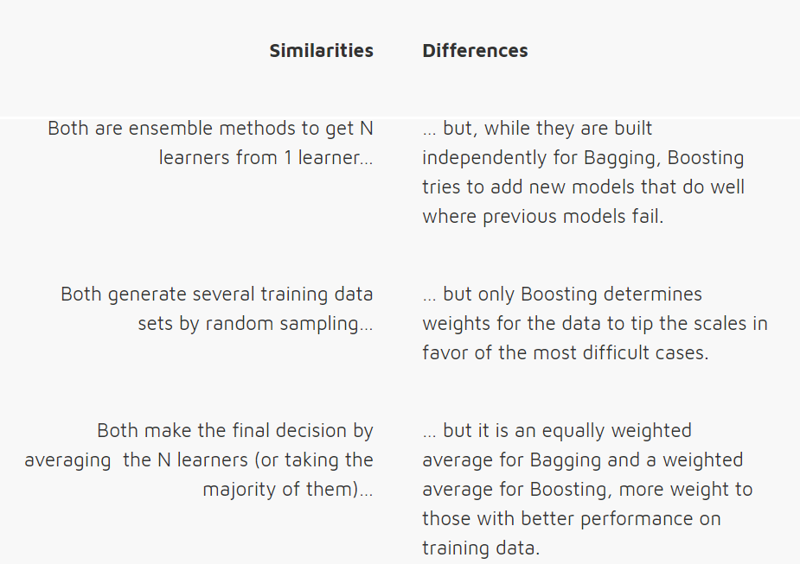
Bagging Vs Boosting

Slide 18
K Means Clustering
K-means clustering is a type of unsupervised learning, which is used when you have unlabeled data (i.e., data without defined categories or groups). The goal of this algorithm is to find groups in the data, with the number of groups represented by the variable K. The algorithm works iteratively to assign each data point to one of K groups based on the features that are provided. Data points are clustered based on feature similarity. The results of the K-means clustering algorithm are:
The centroids of the K clusters, which can be used to label new data.
Labels for the training data (each data point is assigned to a single cluster).
Rather than defining groups before looking at the data, clustering allows you to find and analyze the groups that have formed organically. The "Choosing K" section below describes how the number of groups can be determined.
Each centroid of a cluster is a collection of feature values which define the resulting groups. Examining the centroid feature weights can be used to qualitatively interpret what kind of group each cluster represents.

Slide 19
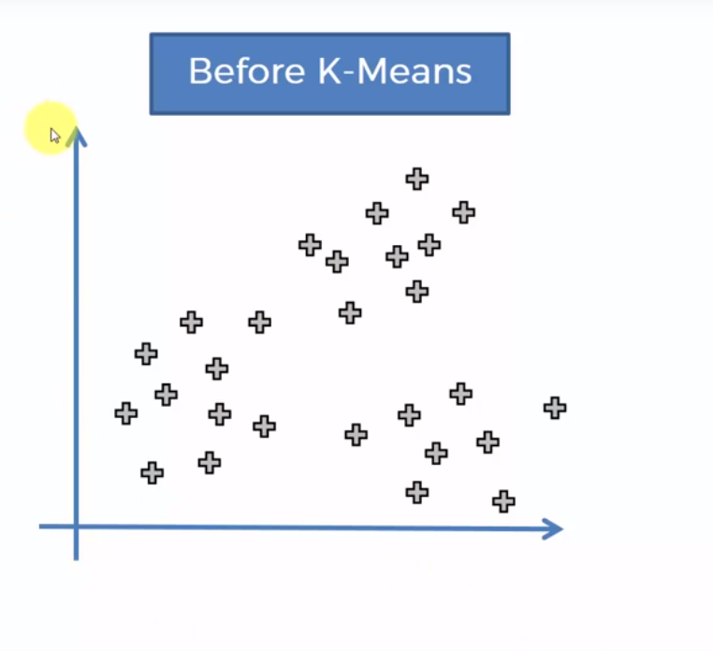
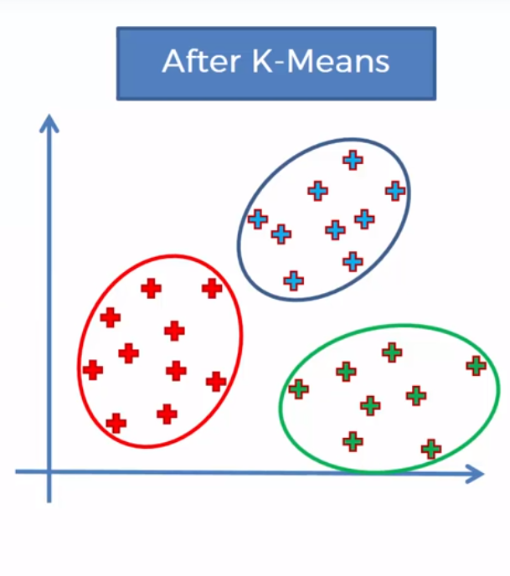
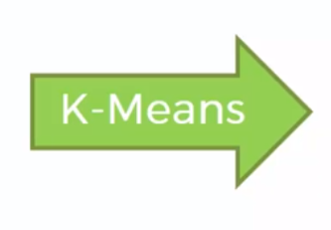
K Means Clustering

Slide 20
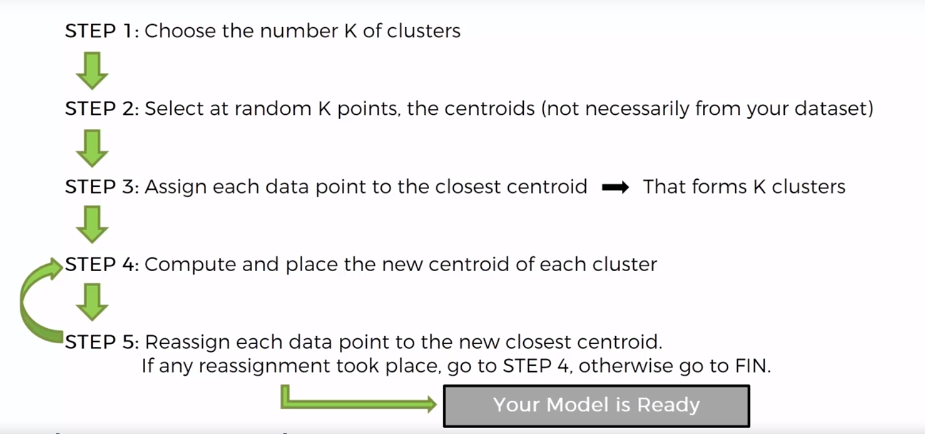
K Means Clustering

Slide 21
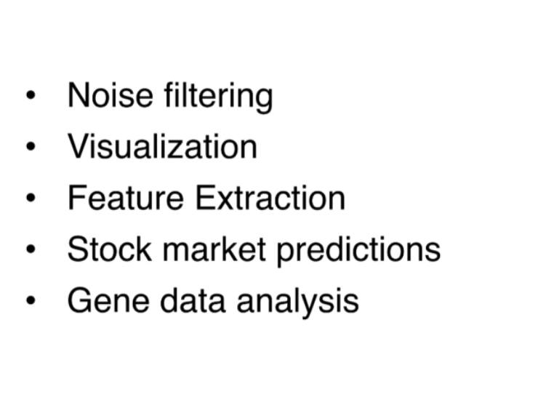
Principal Component Analysis
Principal component analysis is a statistical procedure that uses an orthogonal transformation to convert a set of observations of possibly correlated variables into a set of values of linearly uncorrelated variables called principal components.
PCA is Used in -

Slide 22
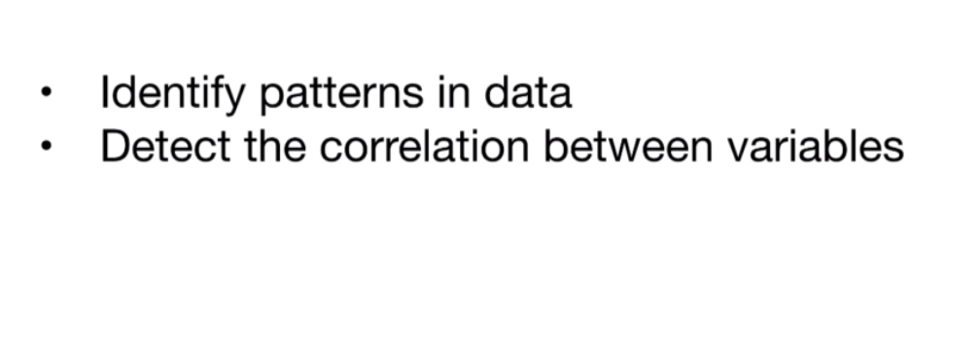
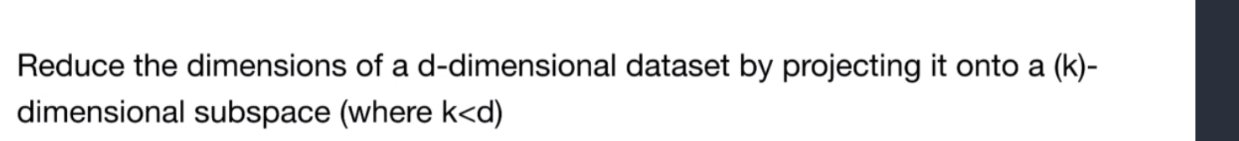
Principal Component Analysis
How to run a PCA:

Slide 23
Principal Component Analysis
How to run a PCA:

